Slide 1

FlyTime
Group 6
Linh, Keith, Tony, Ria, Ethan, Mark
GitHub

Slide 2




Love traveling….?

Slide 3



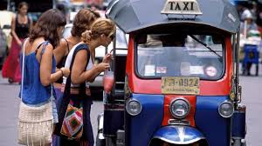

Slide 4
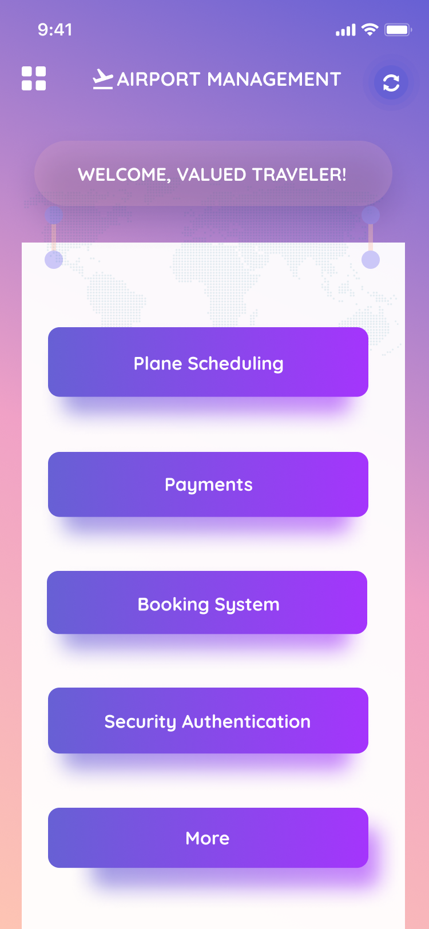
Introduction
FlyTime is an all-in-one airport management application that helps airports, their customers, and various other assets keep track of things such as scheduling and reservations.
The app is useful for frequent fliers, and allows for ease of management.

Slide 5
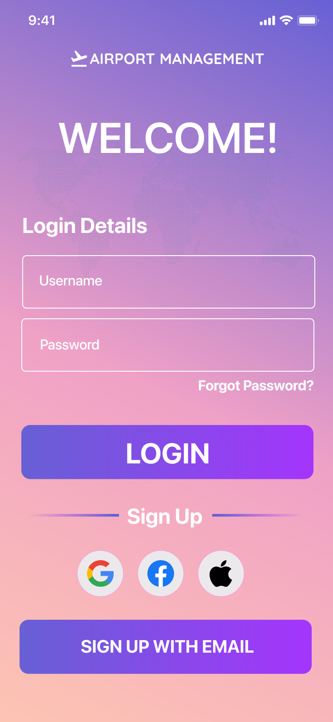
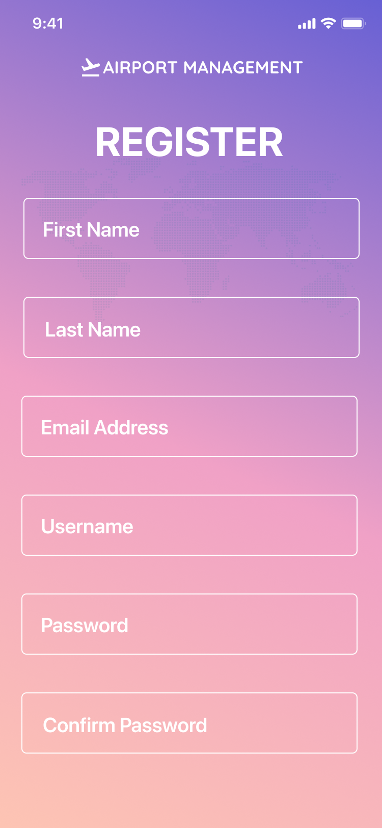
Registration
Sign up through various means
GMAIL
FACEBOOK
APPLE ID
Other EMAIL
Login utilizing the specified information
Notes:
When you first open FlyTime, you are met with a variety of ways to sign up.

Slide 6
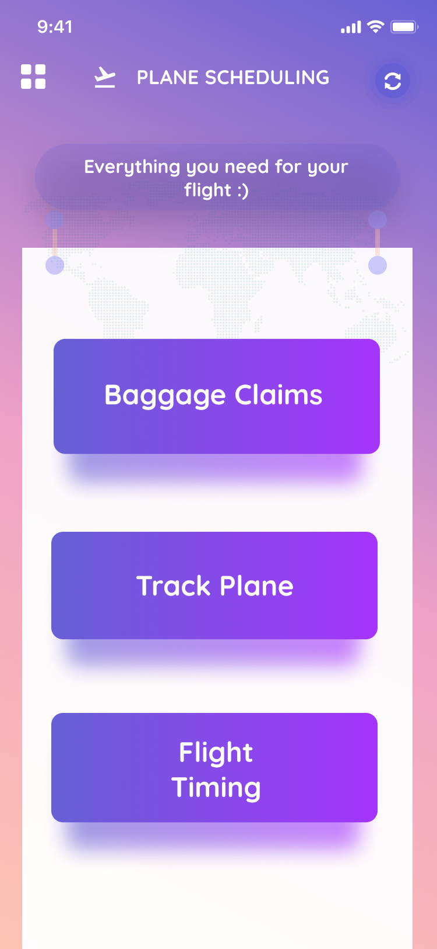
Plane Scheduling
Main hub for plane scheduling
User has ability to choose between
Baggage Claims
Track Plane
Flight Timing

Slide 7
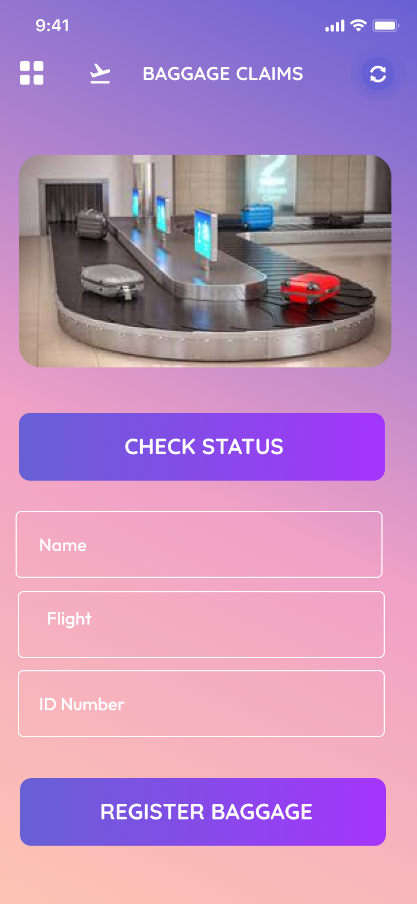
Baggage Claims
Check Status of Bags
In-Transmit
Ready
Baggage Issue
Register Baggage
Used to track baggage
Optional
Confirmation Returned

Slide 8
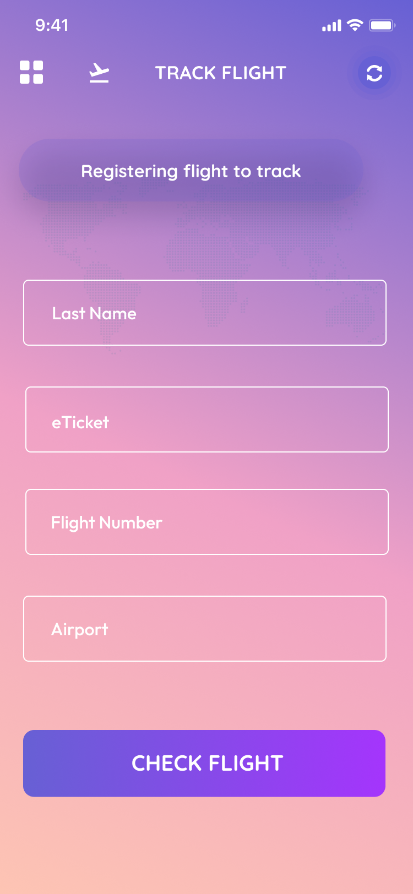
Track Flight
Used in tandem with Flight Timing
Queries database to ensure flight is valid
Connects flight to your account, so that you can see in depth information about your flight.
Optional

Slide 9
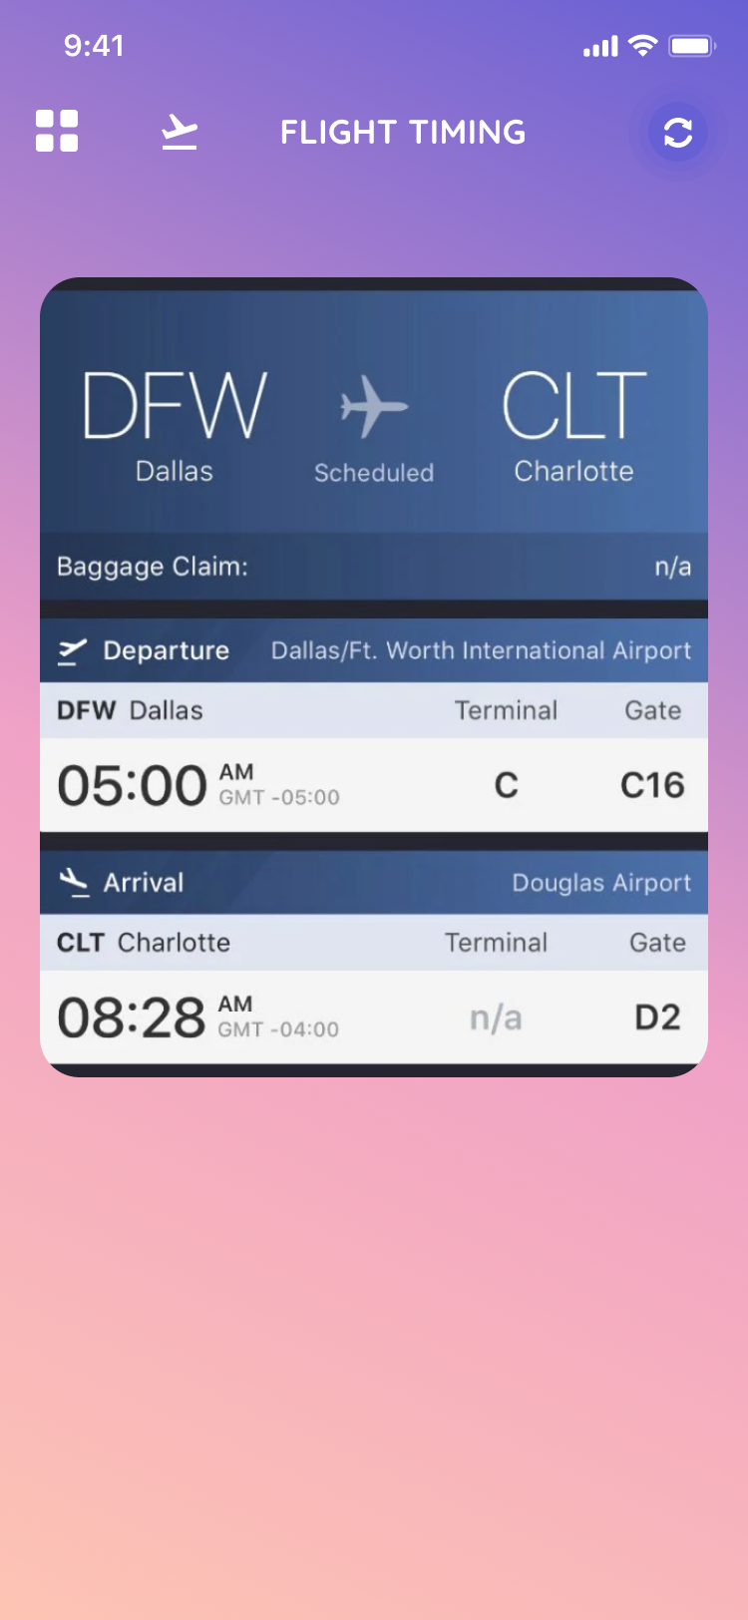
Flight Timing
After plane has been registered for tracking you can view:
Departure time
Terminal
Gate
Delays
Miscellaneous Issues

Slide 10
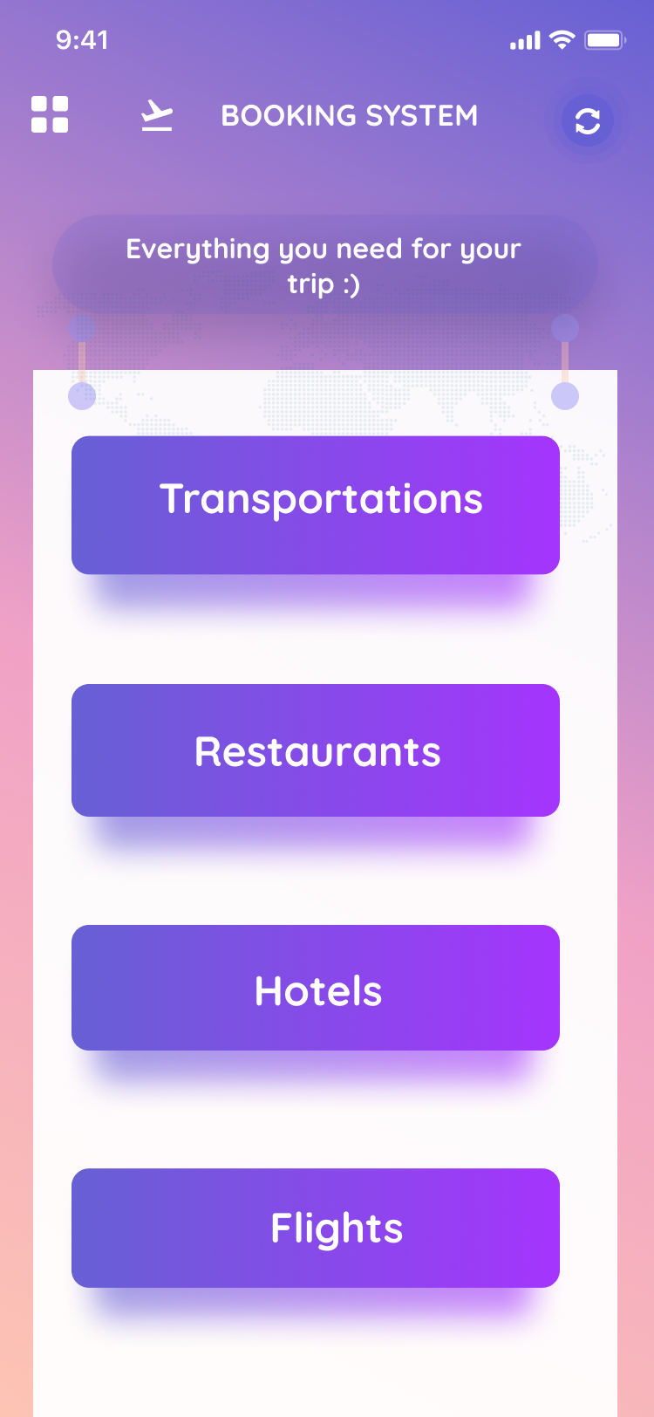
Booking Systems
Help traveler:
Find nearest hotels, restaurants
Find available transportation
Book flights
Each button will lead to each area:
Transportations
Restaurants
Hotels
Flights

Slide 11
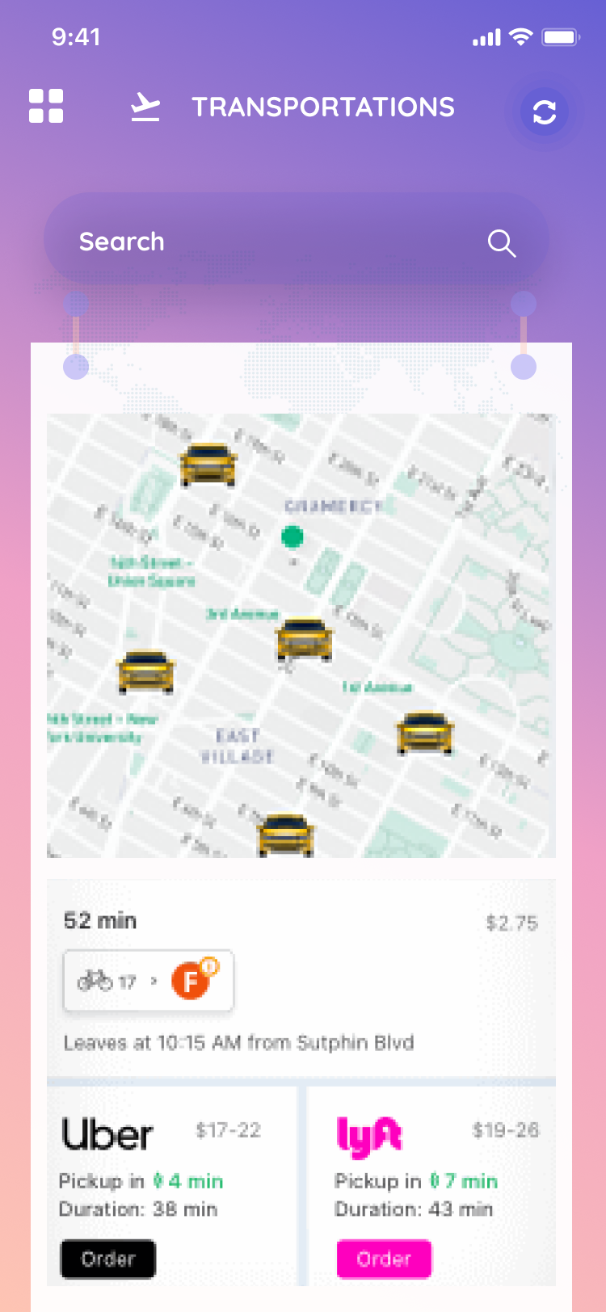
Transportations
The user can use this feature to:
check for available transportations nearby
call and book transportation
Display the information of available transportation nearby
Map
Pickup time
Duration
Price

Slide 12
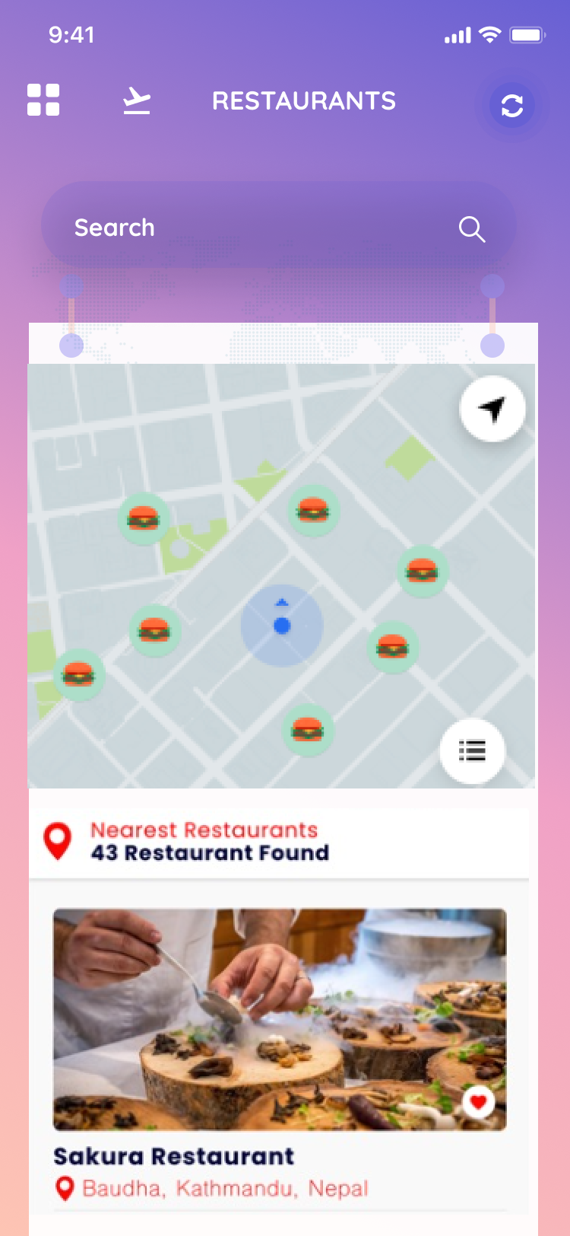
Restaurants
The user can use this feature to:
check for the restaurants nearby
call and make reservations
Display the information of available restaurants nearby
Map/Location
Ranking
Phone Number
Menu/Prices

Slide 13
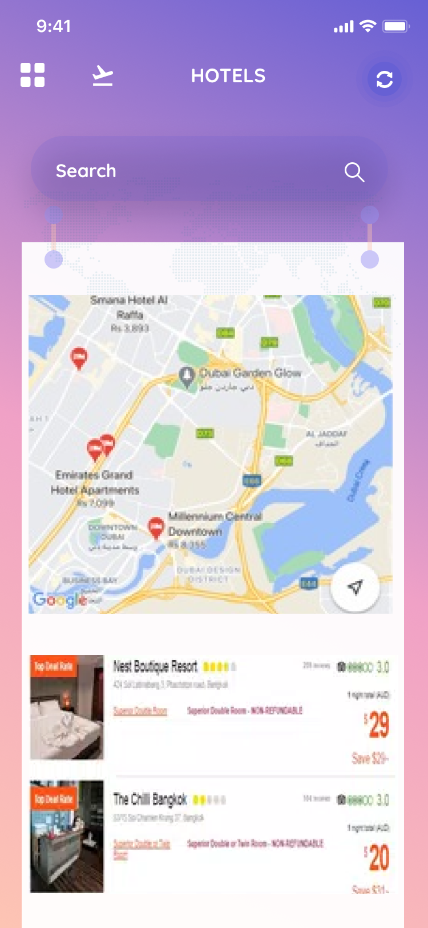
Hotels
The user can use this feature to:
check for hotels nearby
call and book hotels
Display the information of available hotels nearby
Map/Location
Rank
Phone Number
Prices

Slide 14
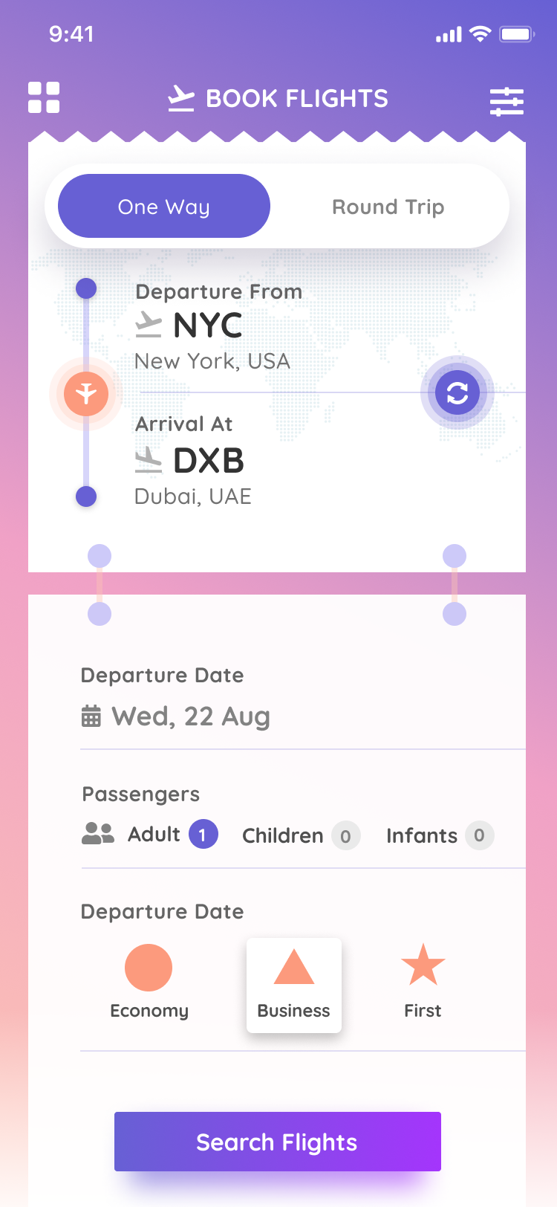
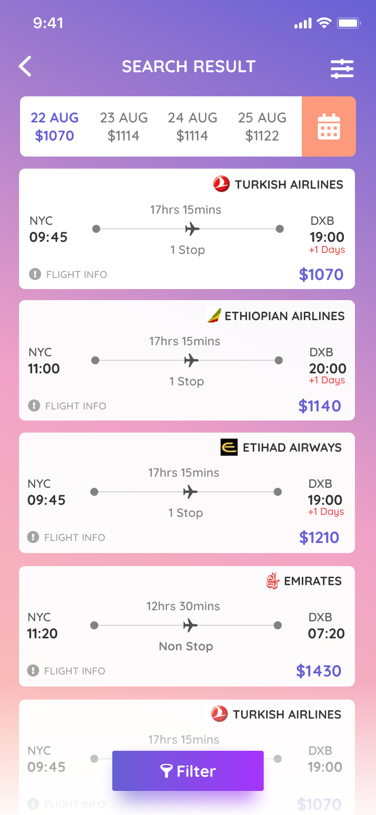
Flights
The user can use this feature to:
Search for the flight ticket information
Book the flight ticket
Options:
Departure From
Arrival At
Departure Data
Passengers
Display the options for the flight tickets with different prices.

Slide 15
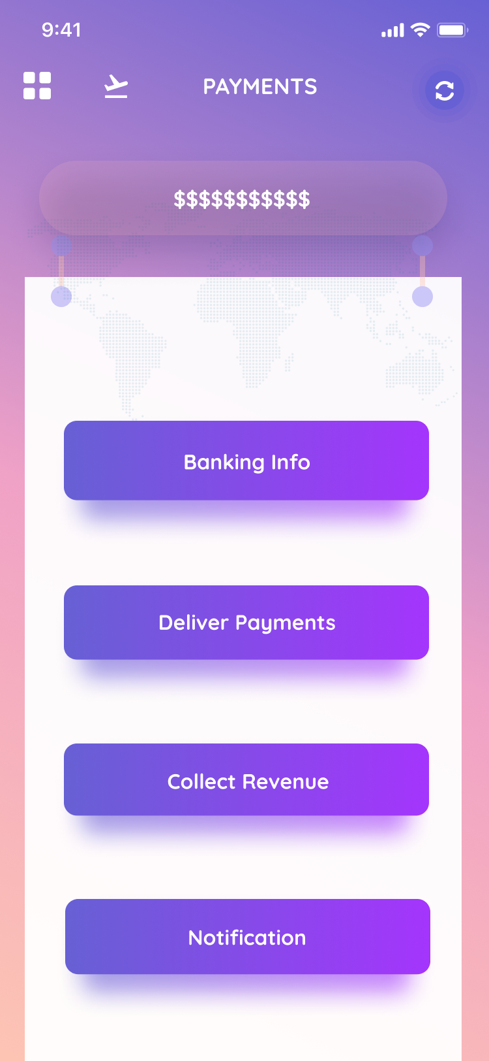
Payments
Payments and transactions are an essential part of any management software.
The Payments screen in our Airport Management app has multiple features:
User can check their banking information by redirecting to their banking app
User can input their banking information
User (specifically a Supervisor) can deliver payments to the workers in the airport
User can collect revenue from all services in the airport (stores, restaurants, etc.)
User can turn on notifications for any info related to payments
Visibility of some features is dependent on the type of user

Slide 16
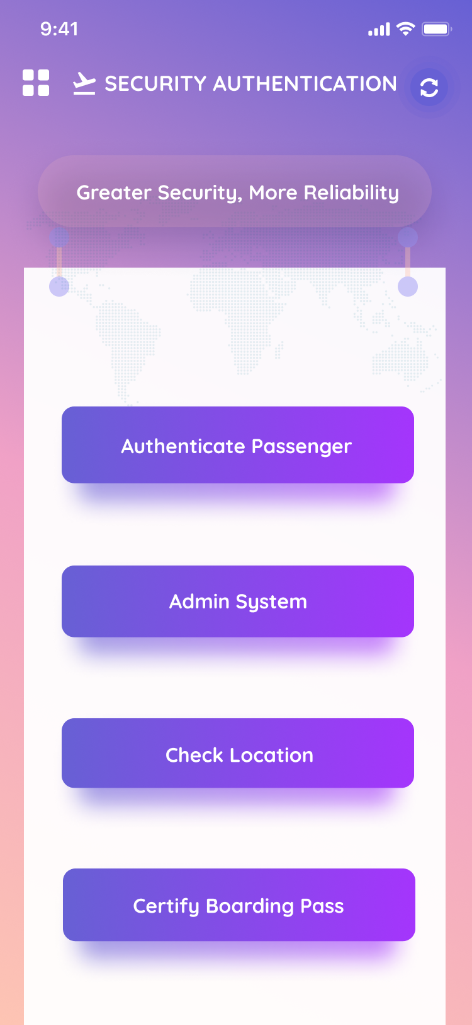
Security Authentication
Authentication is a way to streamline processes and help make the user feel safe
The security authentication screen has a few helpful features
Authenticate Passenger Button: A way for users to confirm that their passport and other ID are verified
Admin System: is for both users and admin
Users will see all permissions and data held
Admins will see all users who have been authenticated and/or certified
Check Location: Is a way for users to to view their location
Certify Boarding Pass: Certifies user’s boarding pass

Slide 17
Challenges & Solutions
Creating appealing features
Determining the cons of airport travel and developing features around making travelling easier
Planning/Coming up with class diagrams
Meeting up and planning out class diagrams together, rather than working individually
Organizing functional requirements
Creating modules/groupings where specific features belong
Combining features where overlap occurred
Coming up with aesthetically pleasing UI
Research in color theory and borrowing ideas from pre-existing, successful apps

Slide 18
Summary
App for managing airport traffic
Plane scheduling to help manage flights
Revenue collection feature for money management of services and worker pay
Booking system to regulate travelers’ reservations
Connecting to other API’s/applications for ease of registration for users
A means for travelers to make their traveling experience easier to manage

Slide 19
Project Management
GitHub:
https://github.com/RiaVadhavkar/FlightManagement

